Slide 1
A Running Moth
Lesson 8

Slide 2


Review
Notes:
2

Slide 3


Slide 4
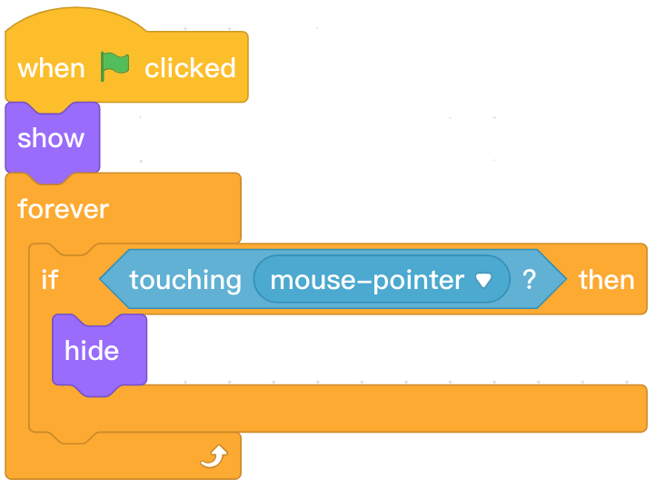
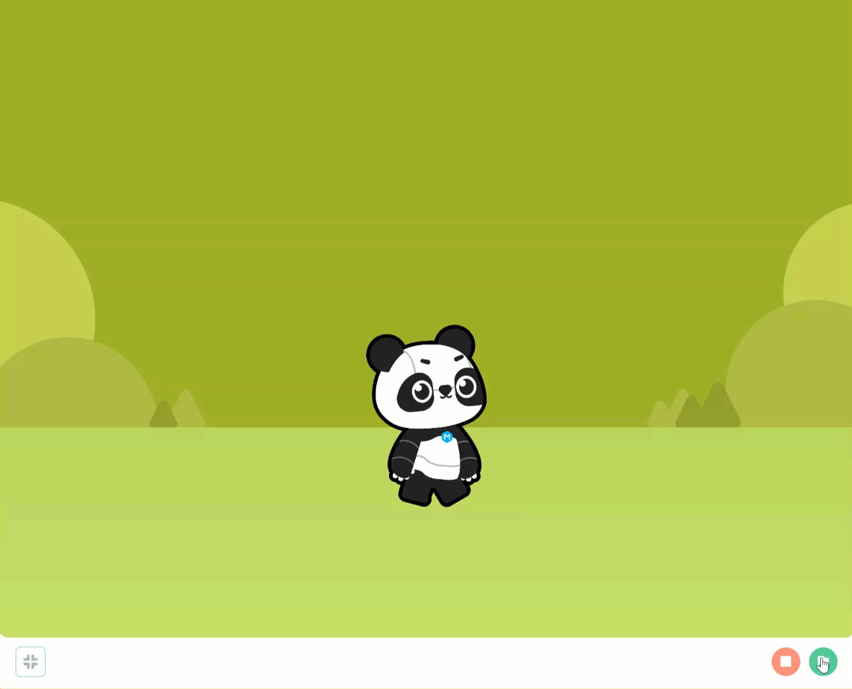
Review
Program | Description
 | Click the green flag, the sprite appears on the stage area; When the mouse pointer touches the character, it disappears.

Slide 5
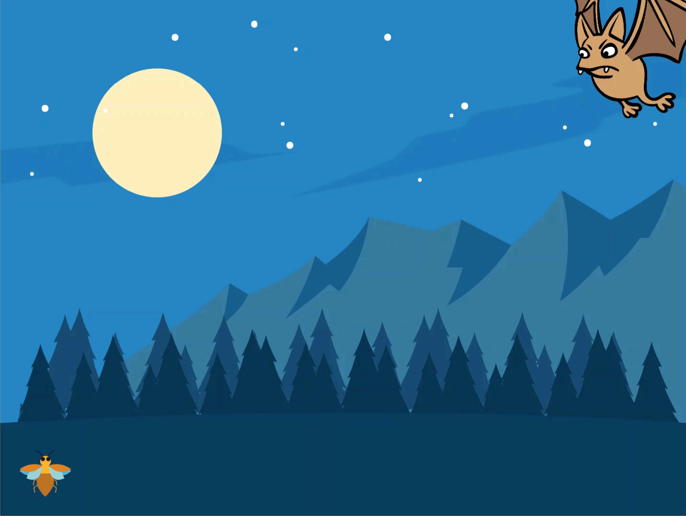

Slide 6
Example Program – A Running Moth
Play the A Running Moth game and explore the program.
Control the moth and run away from the bat so that it is not eaten. Use the arrow keys on the keyboard to control the movement of the moth. If the moth touches the bat, it will fall down from the air and the game will be over.
How long can you stay alive?

Slide 7
Hands On

Slide 8
Conditional Statements

Slide 9
This lesson will the following conditional statements instead of Event blocks:
IF the ↑ up arrow key is pressed, THEN the sprite moves up.
IF the ↓ down arrow key is pressed, THEN the sprite moves down.
IF the ← left arrow key is pressed, THEN the sprite moves left.
IF the→ right arrow key is pressed, THEN the sprite moves right.
IF the Panda touches the opponent, THEN the game is over / stop all scripts.

Slide 10
Changing the Direction of a Sprite

Slide 11
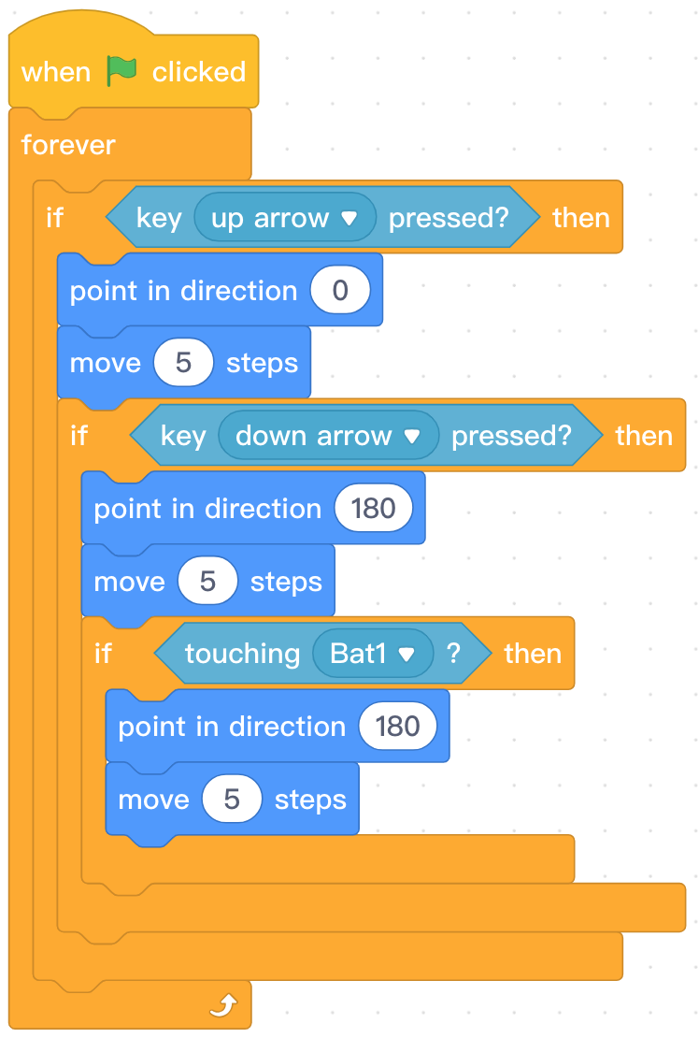

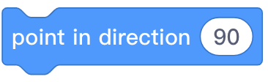
Programming Knowledge
Block Area | Block | Function | Example
Specify the direction the sprite faces. Adjust the direction using the diagram or by inputting a value.
0 Up
90 Right
180 Down
-90 Left

Slide 12


Programming Knowledge
Block Area | Block | Function
Specify the direction the sprite faces. Adjust the direction using the diagram or by inputting a value.
0 Up
90 Right
180 Down
-90 Left

Slide 13
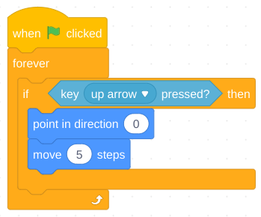

Step 1: Find and select the appropriate blocks from the Block Area to create the following program.
Step 2: Click the in the Stage Area to run the program. Press the up arrow to observe Panda moving up.

Slide 14
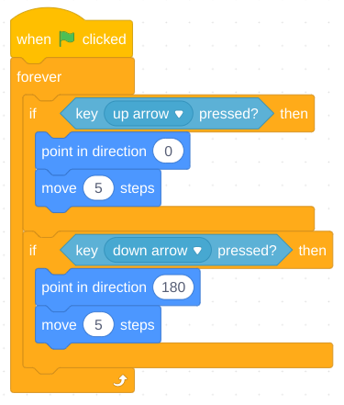
Step 3: Find and select the appropriate blocks from the Block Area to create the following program.
Step 4: Add conditional statements for the
left arrow and the right arrow keys.
Step 5: Click the in the Stage Area to run the program. Press the up arrow to observe Panda moving in four directions: up, down, left and right.

Slide 15
Stop Scripts

Slide 16
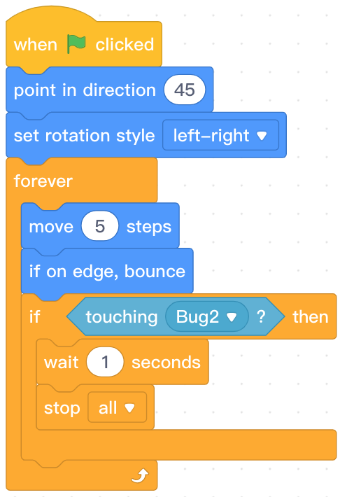


Knowledge
Block area | Block | Function | Example
Stop all scripts of the program.

Slide 17
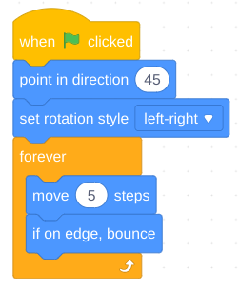
Step 1: Add another sprite of your choosing to your program.
Step 2: Find and select the appropriate blocks from the Block Area to create the following program.
Step 3: Click the in the Stage Area to run the program and observe the opponent sprite moving around the stage.

Slide 18

Step 1: Find and select the appropriate blocks from the Block Area to create the following program.
Step 2: Click the in the Stage Area to run the program. Move the Panda to touch the opponent sprite and observe the program stop.

Slide 19
Let’s try!

Slide 20

Independent Practice A Running moth
Requirements:
Contain two sprites, “Bug2” and “Bat1”, and an appropriate background.
Set starting positions for both sprites using programming blocks when the green flag is clicked.
Program the moth to move using the arrow keys.
Program the bat to fly around the stage after waiting one second to allow the playter time to get ready.
Create an animation of the wings flapping on the bat.
End the game and stop all the scripts when the sprites are touching.

Slide 21
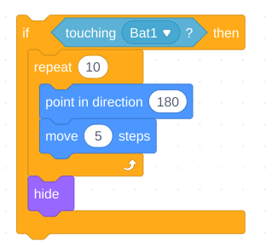
Extension
Challenge students with remaining time to do one or more of the following:
Program the moth to fall and hide when it touches the bat.
Change the transformation effect of the moth when it touches bat. Be sure to reset the appearance effect of the moth at the start of the program.
Add Panda to the program to watch the moth and bat.

Slide 22
Review

Slide 23
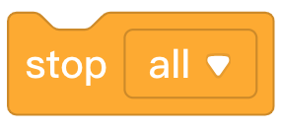
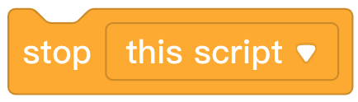
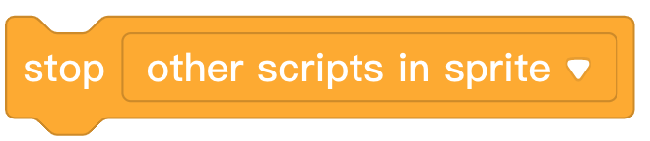
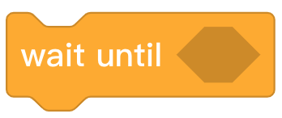
1. From the following options, which block can stop the action of all sprites?
A.
B.
C.
D.
Notes:
Answer A

Slide 24
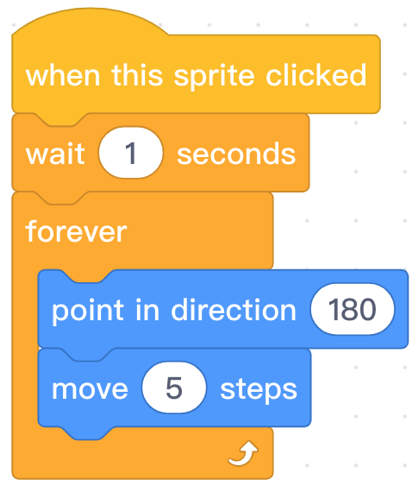
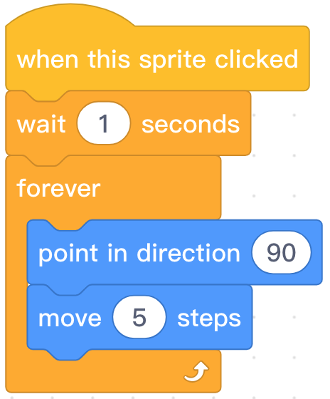
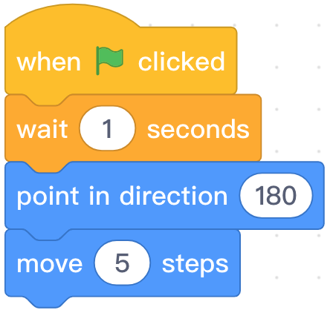
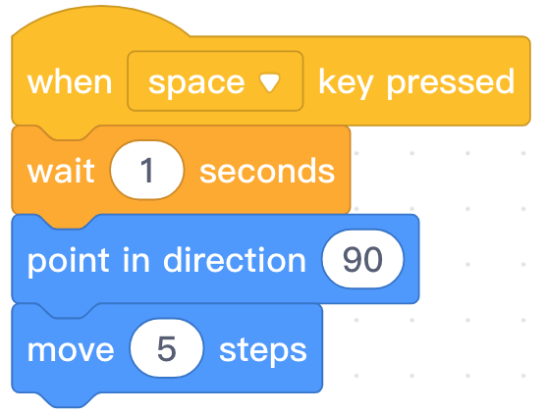
2. Which block combination is used to animate the effect that the character is falling down from the air?
A. B. C. D.
Notes:
Answer B
24

Slide 25
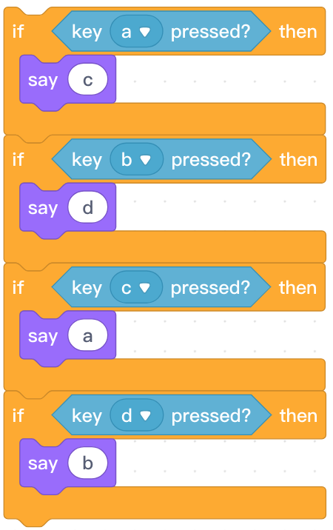
3. When pressing key “C”, what will the character say?
A. a
B. b
C. c
D. d
Notes:
Answer A
25

Slide 26
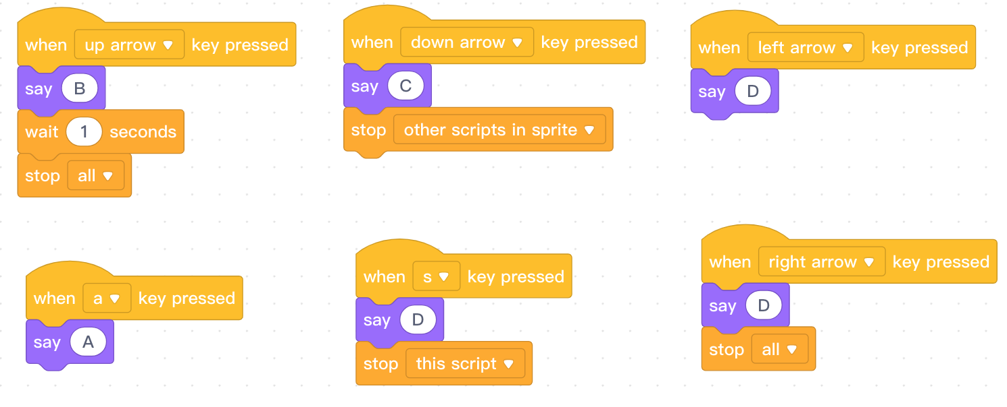
4. Pressing ____ key can realize the effect of “Stop all” running programs immediately.
Notes:
Answer, right arrow

Slide 27
Thank you!

